Slide 1
Final Demo
RF Direction Detection Team 1
Cassandra Harrison, Robert Kramer, Sofia Mvokany, Krishna Patel & Kyle Reagan

Slide 2
Introduction
Goal: Create a system that is able to give the geographical position, angle and spectrum characteristics of a drone flying illegally in 915 MHz frequency range.
Achievable using a wide range rotating loop antenna connected to an SDR that will keep track of drone data spectrum at any given time. The position where the data exchange spectrum is the weakest refers to where the drone is located.
Individuals were assigned tasks on same component areas throughout the semester

Slide 3
Sprint Review/Retrospective
Sprint 1:
Acquire the hardware necessary and brainstorm on the system setup
Sprint 2:
Motor was able to stop at the push of a button
Learned how to use the hardware and software components of drone simulation
Sprint 3:
3D printed platform to connect the loop antenna and motor
Testing to see if signal changed when rotating
Able to acquire real time location of the drone at any time
Focus was integrating the parts into a cohesive prototype

Slide 4
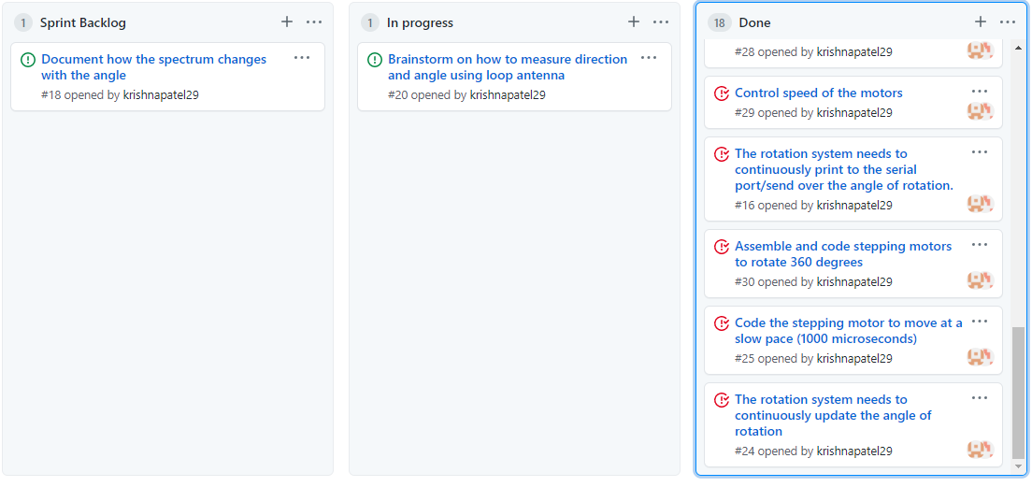
Scrum board overview

Slide 5
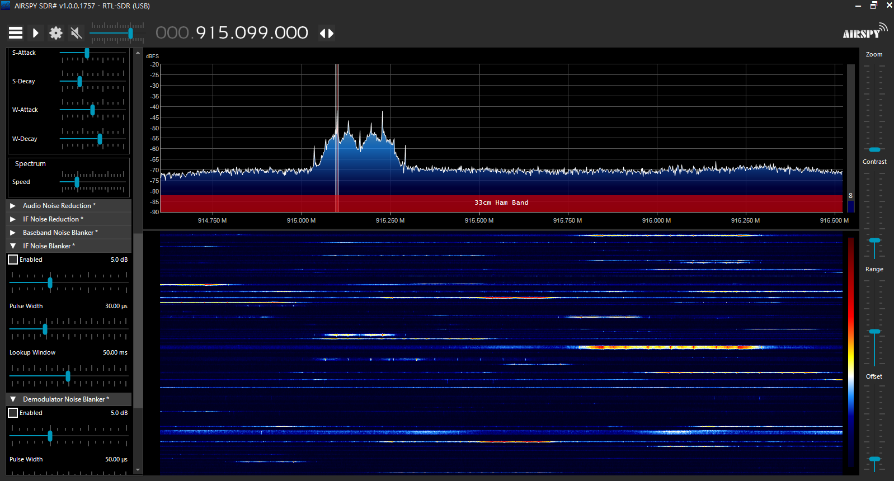
Drone Simulation – Sofia Mvokany
2 Holybro 915 MHz telemetry radios were used for this system
Telemetry radio 1 is connected to a Pixhawk 4
Telemetry radio 2 is connected to a laptop via USB
The spectrum of data exchanged is detected using the RTL-SDR and decoded using Airspy

Slide 6
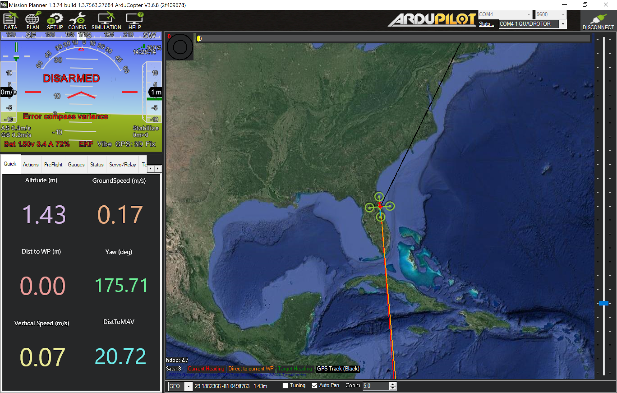
Drone Location – Cassandra Harrision
The Pixhawk configuration with Telemetry radio 1 and GPS creates flight parameters with Mission Planner
Projected flight path uses location to interface in real-time
Result is a functional simulation of a drone to be tracked by telemetry radio 2 in real-time

Slide 7
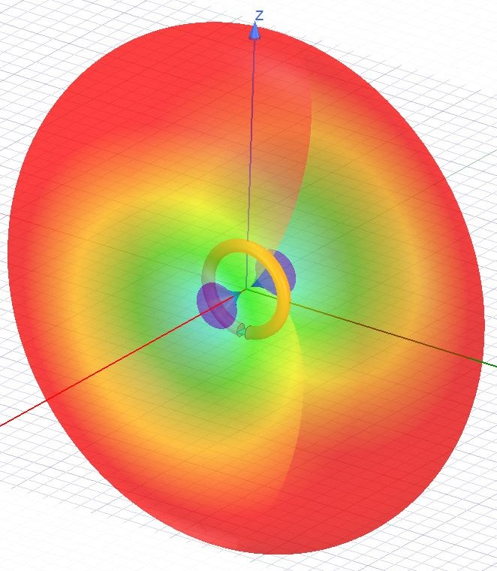
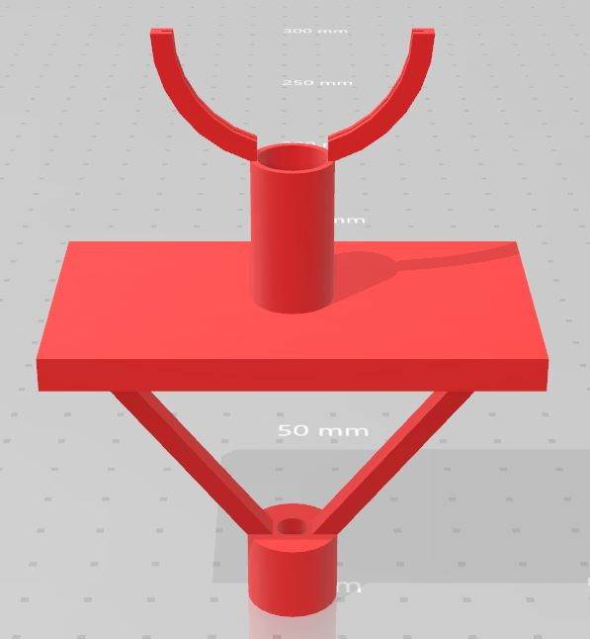
Loop Antenna – Kyle Reagan
Loop antenna designed and simulated with 1/10λ diameter (32.7 mm @ 915 MHz)
Wire runs from antenna to connect to SDR
3D Platform designed to connect antenna to stepper motor

Slide 8
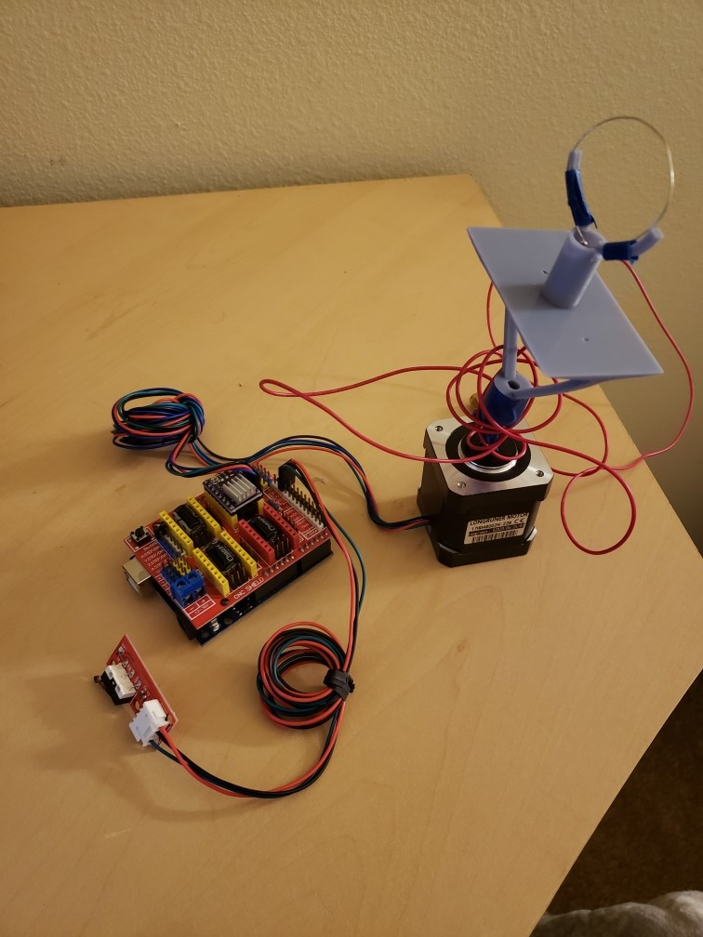
Stepping Motor – Krishna Patel and Robert Kramer
Direction
Coded the motor to be able to move clockwise and counterclockwise
Can rotate 180° or any angle specified in the code
Speed
User can control speed, exact speed wanted can be coded in.
EndStop
When the user presses the endstop switch rotation will stop, when the switch is let go the the rotation will start again.
Angle
Will output the angle every 10 degrees
Can accurately count in full 360 or the 180 that we use
Starts and stops with endstop switch

Slide 9

Video Demonstration

Slide 10
The Future
Extract numerical decoded data from Airspy using DSD+
Develop a technique to match the weakest dB loss with the appropriate angle measurement
Update rotating platform design to fit the loop antenna and stepper motor properly.
Test out using MATLAB/SIMULINK for frequency display.

